Slide 1
UML Interaction diagrams
Sequence and
Communication (Collaboration) Diagrams
COMP 3831
Larman: Chapter 15
W5L2 Interaction Diagrams
COMP 3831 OOA&D

Slide 2
Interaction Diagrams
Illustrate how objects interact via messages
Interaction diagram is a generalization of two more specialized UML diagram types:
  Collaboration diagrams
  Sequence diagrams
Both express similar message interactions
W5L2 Interaction Diagrams
COMP 3831 OOA&D

Slide 3
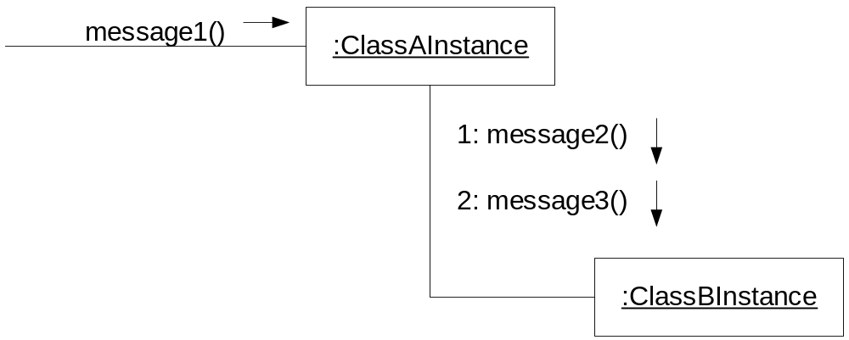
Collaboration (Communication) diagrams
Illustrate object interactions in a network format, in which objects can be placed anywhere on the diagram.
W5L2 Interaction Diagrams
COMP 3831 OOA&D

Slide 4
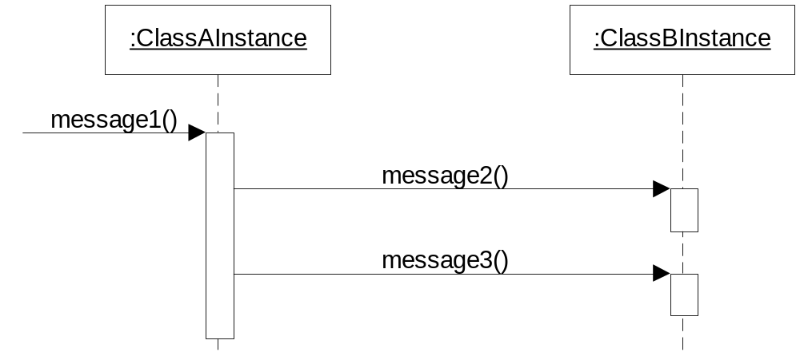
Sequence Diagrams
Illustrate interactions in a kind of fence format, in which each new object is added to the right.
Unlike collaboration diagrams, sequence diagrams do not show links.
W5L2 Interaction Diagrams
COMP 3831 OOA&D

Slide 5
Sequence vs. Collaboration diagrams
Type | Strengths | Weaknesses
Sequence | clearly shows sequence or time ordering of messages simple notation | forced to extend to the right when adding new objects – consumes horizontal space
Collaboration (Communication) | space economical – flexibility to add new objects in two dimensions better to illustrate complex branching, iteration, and concurrent behavior | difficult to see sequence of messages more complex notation
Most prefer sequence diagrams when using a CASE tool to reverse engineer source code as they clearly illustrate the sequence of messages.
W5L2 Interaction Diagrams
COMP 3831 OOA&D

Slide 6
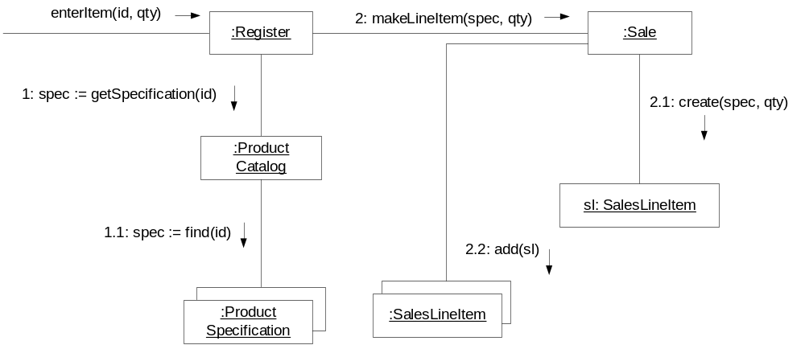
Collaboration diagrams
represent interactions between objects as a series of sequenced messages.
describe both the static structure and the dynamic behaviour of a system.
Unlike sequence diagrams, collaboration diagrams do not have an explicit way to denote time and instead number messages in order of execution.
W5L2 Interaction Diagrams
COMP 3831 OOA&D

Slide 7
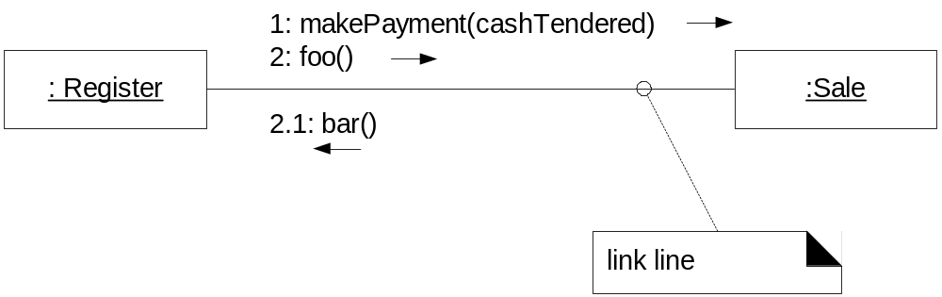
Symbols & Notations
Link:
A connection path between two objects
Indicates some form of navigation and visibility between the objects is possible
Multiple messages can flow along the same single link
Collaboration diagrams
W5L2 Interaction Diagrams
COMP 3831 OOA&D

Slide 8
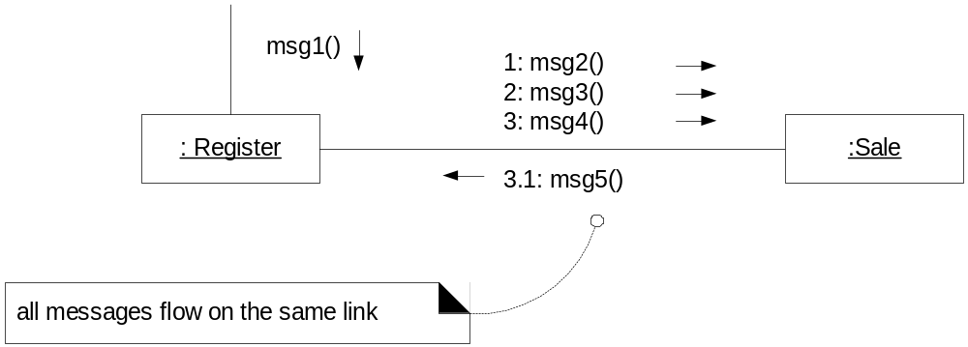
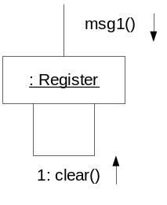
Symbols & Notations (continued …)
Messages (continued)
Represented with a message expression and small arrow indicating direction
All messages flow on same link
Message can be sent from an object to itself
Collaboration diagrams
W5L2 Interaction Diagrams
COMP 3831 OOA&D

Slide 9
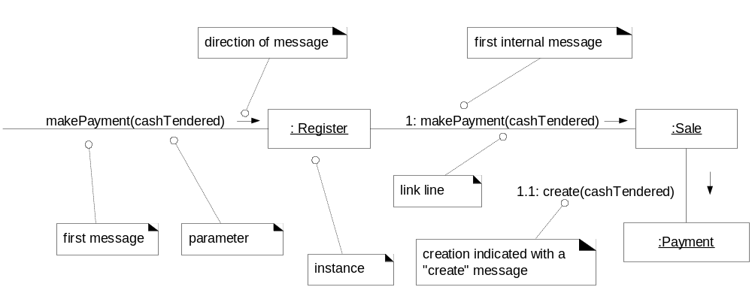
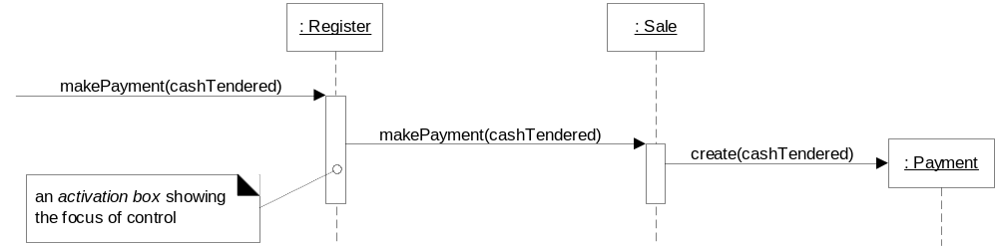
Example interaction diagram: makePayment
The message makePayment is sent to an instance of Register.
The Register instance sends the makePayment message to a Sale instance.
The Sale instance creates an instance of Payment.
Collaboration diagram
Collaboration & sequence diagrams
Sequence diagram
W5L2 Interaction Diagrams
COMP 3831 OOA&D

Slide 10
Suggestions
During the elaboration phase, about a day at the start of an iteration, should be spent on creation of interaction and class diagrams.
  Even though diagrams may be imperfect
Diagrams (interaction and/or class diagrams) are necessary before proceeding to programming.
Create interaction diagrams in pairs. Design will turn out much better and partners will learn quickly from each other.
Collaboration diagrams
W5L2 Interaction Diagrams
COMP 3831 OOA&D

Slide 11
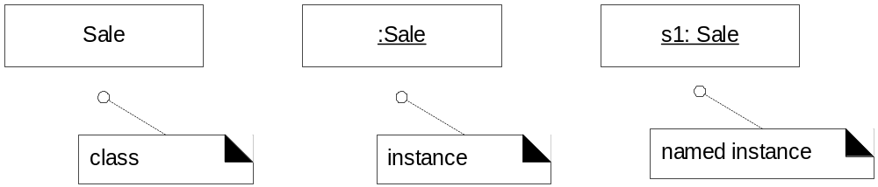
Illustrating Classes & Instances
UML approach to illustrate instances vs. classifiers
  Instance has designator string underlined. Note that a “:” precedes the class name.
  A name can be used to uniquely identify the instance. Again, note that a “:” precedes the class name.
Collaboration diagrams
W5L2 Interaction Diagrams
COMP 3831 OOA&D

Slide 12
UML message expression syntax
return := message(parameter : parameterType) : returnType
Examples:
spec := getProductSpect( id )
spec := getProductSpect( id:ItemID )
spec := getProductSpect( id:ItemID ) : ProductSpecification
Collaboration diagrams
W5L2 Interaction Diagrams
COMP 3831 OOA&D

Slide 13
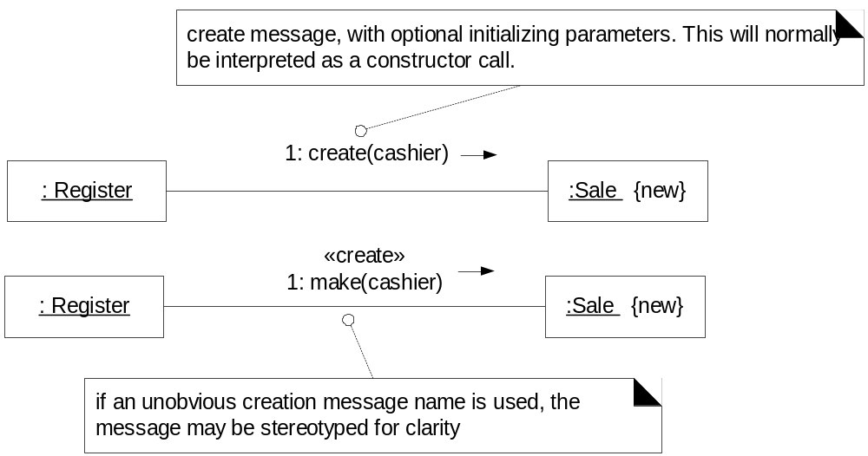
Creation of instances
There is a convention in UML to use a message named create to create an instance
  Create message may include parameters
If another message is used, it may be annotated with <<create>> stereotype
{new} may be optionally added to the instance box to highlight creation
Collaboration diagrams
W5L2 Interaction Diagrams
COMP 3831 OOA&D

Slide 14
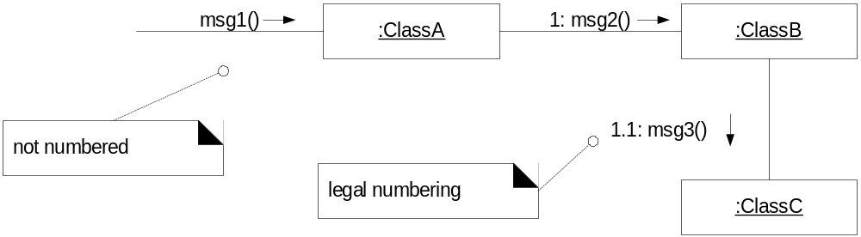
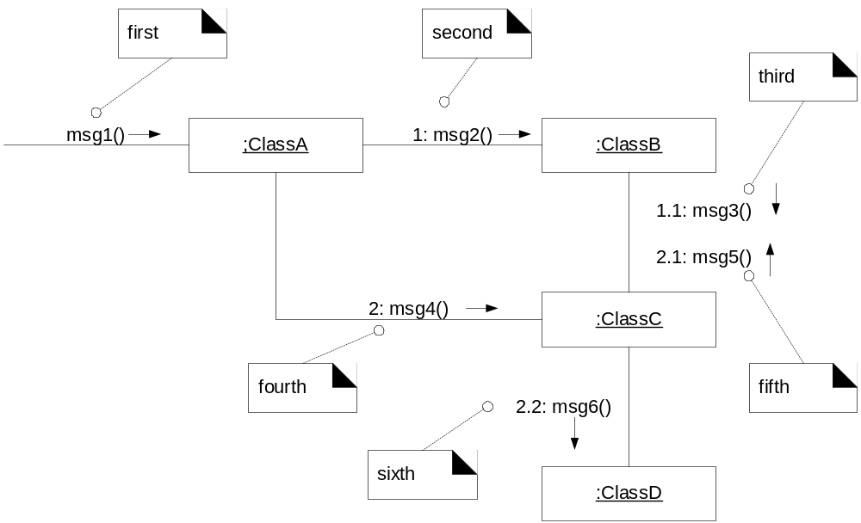
Message numbering sequence
First message is not numbered
Sequence numbering can become nested using legal numbering (the Dewey decimal system). For example, nested messages under the first message are labeled 1.1, 1.2, 1.3, and so on.
Collaboration diagrams
W5L2 Interaction Diagrams
COMP 3831 OOA&D

Slide 15
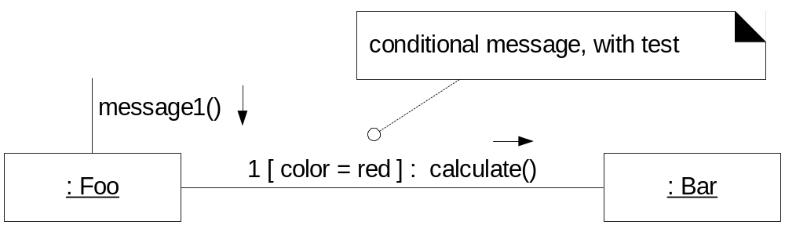
Conditional messages
The condition for a message is usually placed in square brackets immediately following the sequence number.
The message is only sent if the conditional clause evaluates to true.
Collaboration diagrams
W5L2 Interaction Diagrams
COMP 3831 OOA&D

Slide 16
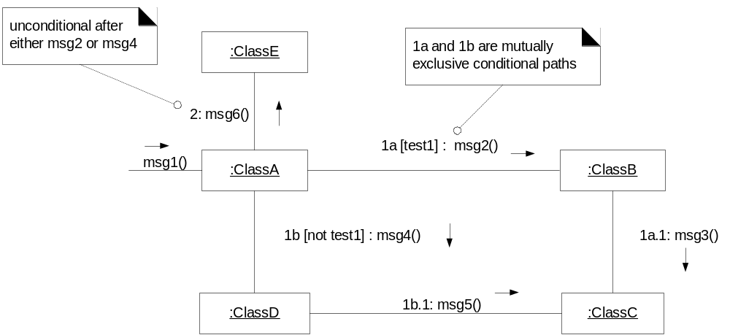
Mutually exclusive conditional paths
Sequence expression modified with a conditional path expression.
First letter is a by convention
  In drawing below, either 1a or 1b could execute after msg1.
  Subsequent nested messages consistently prepended with their outer message sequence (1b.1 is nested within 1b).
Collaboration diagrams
W5L2 Interaction Diagrams
COMP 3831 OOA&D

Slide 17
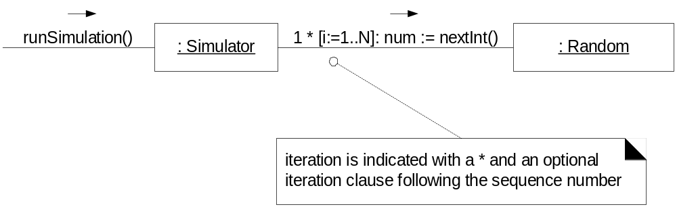
Iteration (looping)
A simple ‘*’ is used with optional iteration clause following the sequence number
Collaboration diagrams
W5L2 Interaction Diagrams
COMP 3831 OOA&D

Slide 18
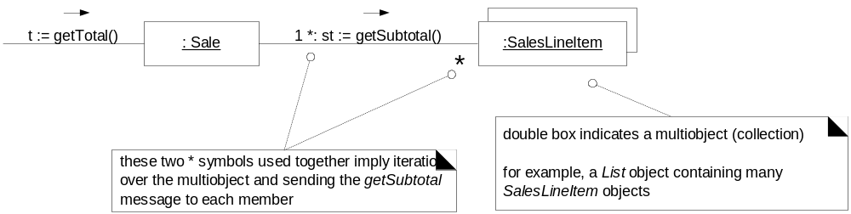
Iteration (looping) over a collection
UML term multiobject is used to denote collection
A ‘*’ multiplicity marker at end of link is used to indicate that message is being sent to each element of collection
Collaboration diagrams
W5L2 Interaction Diagrams
COMP 3831 OOA&D

Slide 19
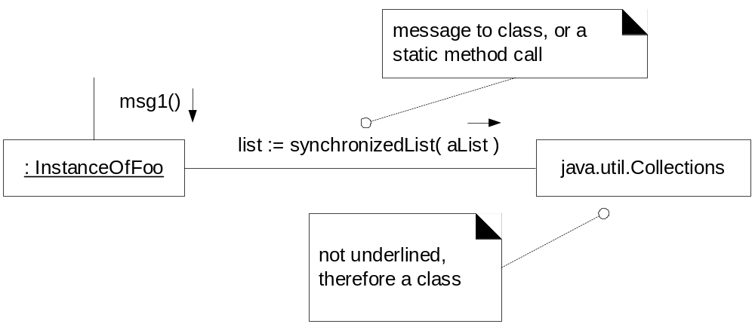
Messages to a Class object
A Class Object contains static methods.
This is shown with name not underlined, indicating that message is being sent to a class rather than an instance
Collaboration diagrams
Be consistent in underlining instance names when instance is intended.
W5L2 Interaction Diagrams
COMP 3831 OOA&D

Slide 20
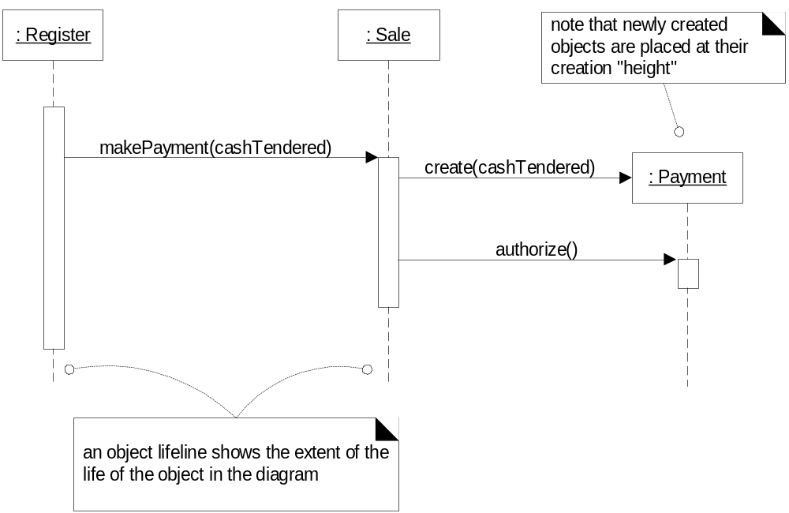
More on Sequence Diagram notation
Creation of instances:
Sequence diagrams
W5L2 Interaction Diagrams
COMP 3831 OOA&D

Slide 21
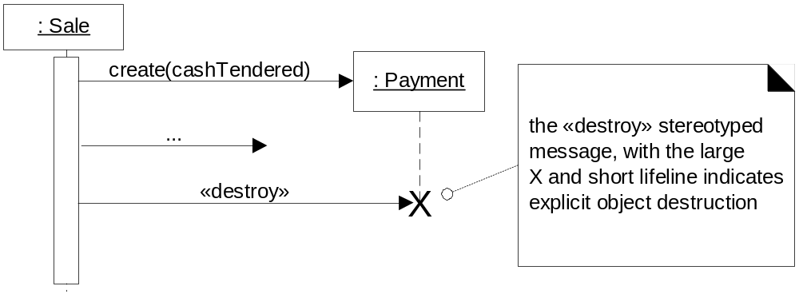
Object lifelines and object destruction
Object lifelines:
  The vertical dashed lines underneath the objects
  These indicate extent of the life of the object
Explicit destruction of an object is expressed as shown below.
Sequence diagrams
W5L2 Interaction Diagrams
COMP 3831 OOA&D

Slide 22
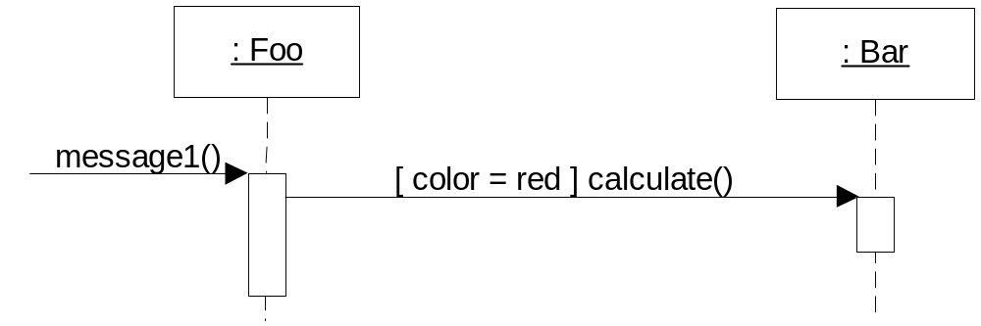
Conditional messages
In sequence diagrams, a conditional message is as shown below.
Sequence diagrams
W5L2 Interaction Diagrams
COMP 3831 OOA&D

Slide 23
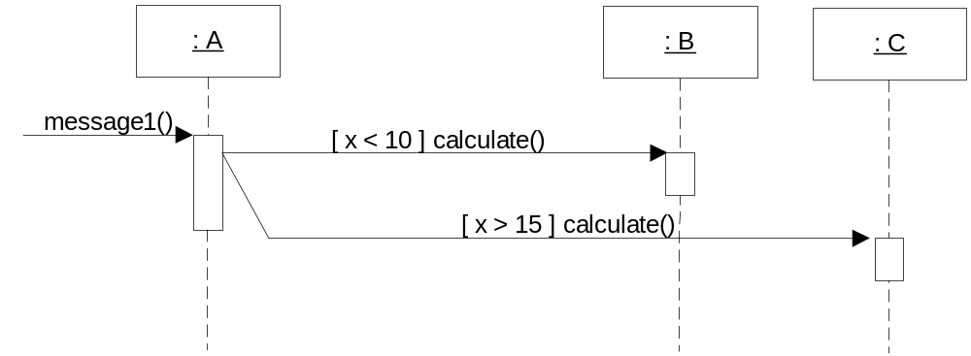
Mutually exclusive conditional messages
Mutually exclusive conditional messages are illustrated with a kind of angled line emerging from a common point, as shown.
Sequence diagrams
W5L2 Interaction Diagrams
COMP 3831 OOA&D

Slide 24
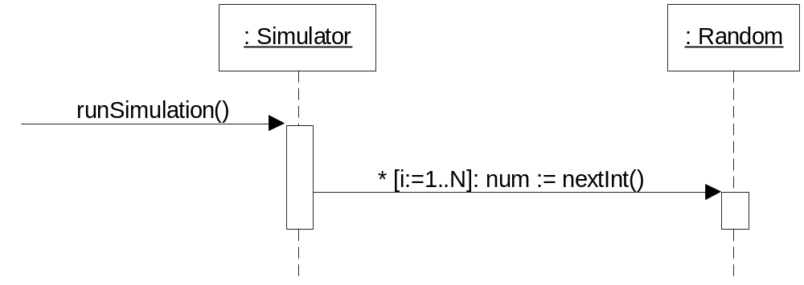
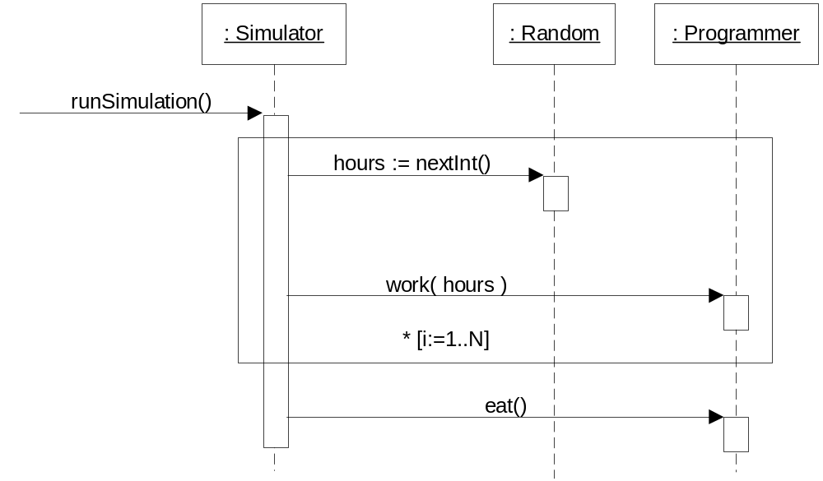
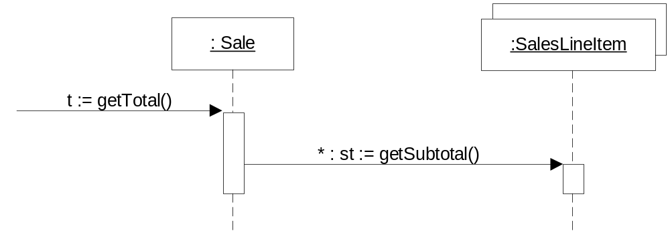
Iteration
Single message
iteration
Sequence diagrams
Iteration of series of
messages
Iteration over
a collection
W5L2 Interaction Diagrams
COMP 3831 OOA&D

Slide 25
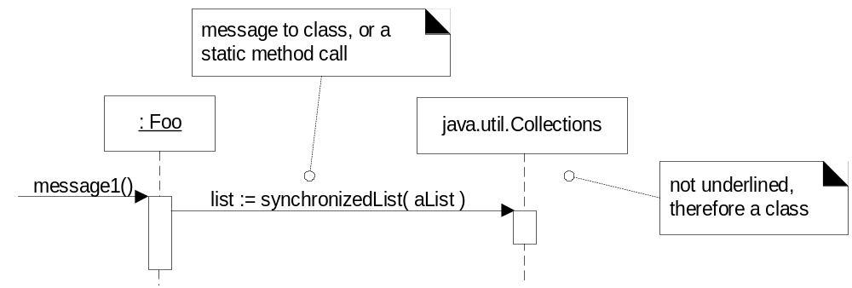
Messages to Class Objects
Class or static method calls are shown by not underlining the name of the classifier, which signifies a class object rather than an instance.
Sequence diagrams
W5L2 Interaction Diagrams
COMP 3831 OOA&D

Slide 26
Questions and Conclusions
W5L2 Interaction Diagrams
COMP 3831 OOA&D

